Slide 1
Amundi Alternative and Real Assets
A specialist of Private Markets, Alternative
and Real Assets worldwide
NOVEMBER 2024
Marketing communication
Document for Professional Investors Only
Data as of 30/09/2024

Slide 2
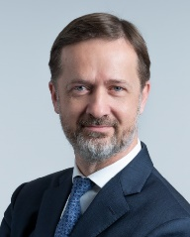
Amundi Alternative and Real Assets
Your Specialist in Global Private Markets, Alternatives and Real Assets
    “Amundi Alternative and Real Assets strives to provide responsible and innovative investment solutions, purely based on private markets, alternative and real assets, to both individual and institutional investors. In the current macroeconomic context, getting access to the right portfolios of real estate, private debt, private equity, infrastructure and alternative assets plays an increasingly crucial role for investors as they look for solutions to meet their needs, such as those for long-term liabilities, securing their retirement plans and fulfilling their ESG and impact objectives, even though those assets involve risks by nature.
    Rooted in Europe’s leading asset manager¹, Amundi Alternative and Real Assets benefits from a privileged environment to originate and finance investment opportunities in the universe of private markets, alternative and real assets. This ecosystem generates investment insights to assess each individual transaction and aims to build resilient portfolios.
    Our value added to investors also results from our ability to structure the right vehicles to ease access to these opportunities. To that end, we offer a wide variety of funds, separate accounts, club deals, co-investments and multimanager structures. Our differentiating competence also consists in reconciling the vehicles and the distribution support required to make alternative and real assets clear and understandable, which makes private markets truly accessible to individuals.
    Leveraging on these skills, we have built an integrated alternative and real assets platform comprised of c. 330 experienced professionals, based in our main investment hubs in Paris, London, Milan, Luxembourg, Barcelona, Madrid, Dublin and Zurich², that manages €71 billion of AuM³. Amundi Alternative and Real Assets is committed to becoming a reference in the world, capable of enabling investors to contribute to funding the real economy.”
Dominique Carrel-Billiard, Global Head of
Amundi Alternative
and Real Assets
1. Source: IPE « Top 500 Asset Manager » published in June 2024 and based on AUM as of end December 2023.
2. The list of cities includes investment hubs.
3. Source: Amundi, as of end September 2024.

Slide 3





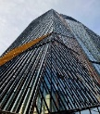





Amundi ALTERNATIVE AND Real Assets (ARA)
€ 71 billion
Assets under
management
c. 330
Employees
and partners
7
Countries with ARA investment hubs
40+ years
In private markets, real assets and alternatives
€35 bn
€8.6 bn
€1.5 bn
€960 m
€20.5 bn
€4 bn
Real Estate
Private Debt
Private Equity
Infrastructure
Multi-Manager Strategies
Alternative Funds Platform
Expert in core/ core+ properties in European prime cities. All segments covered with a focus on offices.
Expert in corporate debt (senior debt and direct lending), commercial real estate debt and LBO debt in the
Eurozone.
Expert in growth capital and buyout in the European mid-market.
Expert in Equity Infrastructure Core/Core+ mainly focusing on investments in renewables, energy transition infrastructure & decarbonization
Expert in hedge fund solutions, and a leading UCITS platform comprising differentiated scalable alternative strategies.
.
Expert in portfolio management and fund selection in private markets and real assets worldwide
Source: Amundi Alternative and Real Assets, as of end September 2024. The figures take into account the acquisition of Alpha Associates (signature on 06/02/2024 and closing on 02/04/2024).

Slide 4

We have expanded our capabilities to offer innovative solutions in hard-to-access markets
ARA’s key milestones since 2016
2016
2017
2018
2019
2020
2021
2022
2023
2024
Integration in a single business line of all capabilities in alternative assets: Amundi Real Assets was born
Creation of Amundi Energy Transition
Merger with Crédit Agricole Immobilier Investors to further streamline the integration
Launch of the first commingled fund of European Leveraged Loans
Launch of a European Real Estate Loans Strategy & Team based in Paris
Launch of our first retail multi-management Real Estate fund
Launch of an Impact strategy in Corporate Private Debt aimed at Institutional investors
Acquisition of Lyxor Asset Management
Launch of an SFDR
Art 8 Real Estate strategy focused on healthcare
Launch of a Megatrends Private Equity program on European SMEs
Launch of Agritaly, a food inventory debt financing expertise in Italy
Launch of a multi-management multi-alternative assets HNW fund through a white labelling partnership
Creation of Supernova Invest with the CEA* to invest in French Tech startups
Integration of the Impact Investing team
Launch of the 1st Green Infrastructure retail fund: “Amundi green energy”
Launch of Amundi’s first pan European cross-border alternative solution with a first ELTIF program in Leveraged Loans
Integration of the Alternative Funds Platform, previously part of Lyxor AM
Launch of a Direct Lending Impact solution focusing on the Agri-Agro sector
Acquisition of Alpha Associates (signing on 06/02/2024; closing on 02/04/2024)
* French Alternative Energies and Atomic Energy Commission

Slide 5
Overview of our Current range of investment solutions
We offer innovative and long-term solutions to institutional and retail investors through a wide variety of funds, separate accounts, club deals, impact funds, co-investments, advisory and multi-manager structures
Closed-ended Funds
Open-ended Funds
Dedicated Funds
Advisory Mandates
Club Deals
Co-investments
Multi-management
ELTIF Products
UCITS/AIF Products
Impact Funds
European Core/Core+ properties, all segments with focus on offices
Real Estate
Eurozone Senior Debt: Corporate debt, Real Estate Loans, Leveraged Loans, Agri-financing
Private Debt
Growth Capital and Buyout on European mid-caps and small-caps
Private Equity
Energy transition assets - electricity generation and energy efficiency
Infrastructure
Hedge fund strategies: Global Macro, Merger Arbitrage, Long/Short Credit, Long/Short Equity, CTA trend following
Alternative
Funds Platform
These solutions are available to investors that are willing to take the risks involved with these investments and in return for an annual management fee

Slide 6





real estate
N°2 in Retail Real Estate funds in France by AuM¹
€35 bn
of AuM
135
Dedicated people
≈1 200
Properties in Europe
4-star PRI rating for Real Estate direct²
A leader in European prime cities
Overview of Amundi Real Estate assets per country
Amundi Real Estate is a company specialized in developing, structuring and managing European property funds.
Amundi Real Estate carried out the largest transactions in the European market, with €3 bn of acquisitions and a total of €6.2 billion in transactions over the last 4 years (2020-2023).
Amundi Real Estate sources assets across Europe, structures the acquisitions and their financing, and manages all type of properties with a focus on Offices
*Luxembourg, Austria, Poland, Ireland, UK, Nordics
Source: Amundi Real Estate, as of end June 2024
A comprehensive offering
Overview of Amundi Real Estate assets per sector
Commingled Funds (closed-end and open-ended); Dedicated Funds; Club Deals & Joint Ventures; Mandates, tailor-made solutions and Funds of Funds.
A leading player in managing and structuring regulated funds in France¹.
A gate keeper for international clients looking to access the European Real Estate market for diversification purposes.
Source: Amundi Real Estate, as of end June 2024
Source: Amundi Real Estate as of end September 2024. ¹ Source: ASPIM as of end September 2024. ² Source: PRI Assessment Report 2023. Please find the full report as well as the PRI Transparency Report at the following link: Amundi PRI Documentation 2023.

Slide 7

private debt
€8.6 bn
of AuM
35
Dedicated people
2012
First fund launch
4-star PRI rating for Private Debt1
A continuum of Europe’s largest fixed income platform
A 35-people team leverages the fixed income platform developed by Amundi, European leader in bond management with c. €800bn of assets under management and 40+ years of successful track record in Alpha Fixed Income Strategies.
The team has a direct access to mid-market companies in the Eurozone through Group Crédit Agricole’s banking networks, a diversified network of prime contacts with investment banks, debt advisors and real estate developers, and partnerships.
The size of this activity, and the fact that it is deeply-rooted in Amundi’s bond management operations, facilitates economies of scale, making it possible to price each solution in a suitable manner for investors. It is also a guarantee of a renowned risk control process and operating framework.
1+ billion € invested each year on average
3 Areas of Expertise
c.7%
Hit Ratio
Corporate debt
(senior debt, direct lending)
Leveraged loans
Real estate debt
Capacity to deploy capital while being very selective
Amundi operates primarily on the corporate private debt market. It is particularly active in senior debt and European mid-cap LBOs, and in the financing of real assets, including agri-food and real estate.
Securing investments is particularly important to our specialists, leading to very thorough legal due diligence and credit analysis as well as adapted financial documentation.
ESG is at the heart of our strategy, from selecting companies to negotiating financial documentation, contributing to the improvement of extra-financial performance during credit life and reporting to investors.
Amundi, data as of end September 2024. ¹ Source: PRI Assessment Report 2023. Please find the full report as well as the PRI Transparency Report at the following link: Amundi PRI Documentation 2023.
These solutions are available to investors that are willing to take the risks involved with these investments and in return for an annual management fee

Slide 8
PRIVATE equity
€1.5 bn
of AuM
16
Investment
Professionals
1998
Launch date
Amundi Private Equity Funds has signed the International Climate Initiative manifesto
4-star PRI rating for private equity direct²
A team dedicated to the development of SMEs
A team of 16 investment professionals with 20+ years of experience, focusing on two complementary strategies: Midcap and Impact.
A solid track record of performance: gross IRR of 23%¹ and a multiple of 2.3x¹ (Midcap track record)
A strong value proposition: Amundi provides its financial power, business networks, assistance with internationalization and solid ESG and impact expertise to the companies it supports (see next page).
An active minority investor positioning
Access to entrepreneurial and family-owned companies where executives and families want to retain control.
Allowing attractive entry prices due to less competition in this market segment.
Active participation in corporate governance by participating in strategic decisions without interfering in day-to-day management.
Active support to the company’s growth strategy (organic or external), internationalization plan and digital and environmental transition.
Investing in SMEs with leading positions in their sector
We make equity investments of €20 million to €50 million in unlisted companies with profitable growth that are leaders in their market segment and that benefit from at least one of the following megatrends: Technology, Demographics, Economic Transformations, Environment, Societal changes.
We enable institutional investors and high-net-worth individuals to gain access to the equity of high-growth potential companies via our different types of funds (FPCI “Professional Private Equity Investment Fund”, FCPR “Venture Capital Mutual Fund”, FCPI “Innovation-focused Mutual Fund”, FPS “Professional Specialized Investment Fund”).
Sources: Amundi Private Equity Funds as at end of end September 2024.¹ Track record from 2010 to end-December 2023. Past performance is no guarantee of future results. ² Source: PRI Assessment Report 2023. Please find the full report as well as the PRI Transparency Report at the following link: Amundi PRI Documentation 2023.
These solutions are available to investors that are willing to take the risks involved with these investments and in return for an annual management fee

Slide 9




ZOOM ON OUR IMPACT INVESTING APPROACH TO PRIVATE EQUITY
An expertise devoted to impact investing
Amundi Finance & Solidarité
To be at the side of savers and investors to accompany them in the impacts to which they wish to contribute.
France's leading Fund
in the social and solidarity economy today
Our positioning
€580 M of assets under management thanks to the trust of nearly 1 million solidarity savers and large institutions concerned about the most fragile people.
Principle of providing financing to sustainable social companies: 53 companies financed and supported to date.
5 investment themes aimed at meeting the essential needs of men and women: house affording, employability, access to health, education and protection of natural resources.
Amundi Finance et Solidarité celebrated its ten-year anniversary in 2022
Investment themes that are aligned with the UN’s 17 SDGs¹. These goals involve meeting the basic needs of women and men
Our references
Our goal
Combine the search for financial performance with measurable social and/or environmental performance.
Source: Amundi Private Equity Funds as of end September 2024. ¹ United Nations’ Sustainable Development Goals.
These solutions are available to investors that are willing to take the risks involved with these investments and in return for an annual management fee

Slide 10



INFRASTRUCTURE – AMUNDI ENERGY TRANSITION
€960 m
of AuM
+1 200
Properties in Europe
14
Dedicated people
2016
Launch date
4-star PRI rating for Infrastructure¹
An asset management company dedicated to the energy transition
~€2bn
In investment
capacity
AET manages Infrastructure Equity Funds (Core/Core+) dedicated to mid-market Green Infrastructures, with a strategy focused on Europe and OECD, on the Energy Transition & Decarbonization sectors, with strong focus on:
Creating value through a “Buy & Build” and platform approach and an active asset management
Deploying capital at an attractive and sustainable risk-adjusted return profiles, with a strong downside protection
Making ESG an integrated part of AET’s investment approach to monitor risks and create long term value
8
Institutional
funds
1
Retail
fund
An innovative business model
AET benefits from solid industrial know-how and financial expertise in the risks associated with energy projects. The team benefits from a strong network with a global reach, and is able to leverage:
its wide and deep market relationships and network to secure off-market opportunities
the Amundi and Crédit Agricole global platform with local partners to create exclusive investment opportunities
+400
Assets in its
portfolio
~2,100MW
Under
management
Source: Amundi Energy Transition. All figures as at end of end September 2024.
¹ Source: PRI Assessment Report 2023. Please find the full report as well as the PRI Transparency Report at the following link: Amundi PRI Documentation 2023
These solutions are available to investors that are willing to take the risks involved with these investments and in return for an annual management fee

Slide 11




ALTERNATIVE FUNDS PLATFORM
€4 bn
of AuM
9
Investment
Professionals
25+
Years of experience
Pioneer in
Managed Account Platforms
Access to best-in-class hedge fund managers in a UCITS format
Amundi partners with high conviction managers to offer global investors commingled UCITS funds with competitive risk-return profiles.
We select our partners for their experience and track-record in operating their differentiated, alpha generating and scalable investment strategies.
We have nurtured privileged relationships with renowned names in the alternative segment, and have the structuring skillset and infrastructure to replicate these strategies in UCITS format.
Analytics
Dedicated portfolio management and advisory services
Transparency
A team of 5 hedge fund investment and operational due diligence professionals covering the full spectrum of alternative strategies.
A team of 4 portfolio managers sitting within Amundi Multi-Asset Solutions dedicated to alternatives, providing access to the Amundi open-architecture fund platform and analyst recommendations.
An investment process designed to manage separately the 3 main components of alternative fund returns : the market beta, the alternative betas and the manager alphas.
Access to managers
Source: Amundi. All figures as at end of end September 2024.
These solutions are available to investors that are willing to take the risks involved with these investments and in return for an annual management fee

Slide 12




PRIVATE MARKETS MULTI-MANAGER STRATEGIES
€20.5 bn
of AuM
c. 70
Dedicated people
1998
Launch date
5-star PRI rating¹
Established, Specialised Private Markets Manager
Coverage of the main private markets asset classes
Amundi Alpha Associates is Amundi’s private markets multi-manager platform, comprising 2 offices, in Paris and Zurich.
The Paris-based Amundi private markets multi-manager business started in 1998. The Zurich-based Alpha Associates was founded in 2004 and combined with Amundi in 2024 to create Amundi Alpha Associates;
Excellent credentials: AMF- & FINMA-authorised² manager of the assets of collective investment schemes, with 100+ institutional investors;
A solid track record: leading manager with 25+ years of investment experience in private markets and 1000+ target funds.
€9.7 Bn
€5.7 Bn
Global or geographically focused portfolios diversified across managers, stages and sectors
Global portfolios focused on brownfield investments with a mix of core and core-plus strategies and annual distributions
€4.4 Bn
€0.6 Bn
Portfolios of first lien direct lending funds and SMAs in Europe and North America with annual distributions
Global coverage of real estate markets through a diversified strategy ranging from core to opportunistic.
Source: Amundi as of end September 2024. The figures take into account the acquisition of Alpha Associates (signature on 06/02/2024 and closing on 02/04/2024).
¹ Source: PRI Assessment Report 2023. The score refers exclusively to the Zurich hub.
² Amundi Alpha Associates AG is regulated by the Swiss Financial Market Authority and Amundi Private Equity Funds, S.A.S. is regulated by the French Autorité des Marchés Financiers.
These solutions are available to investors that are willing to take the risks involved with these investments and in return for an annual management fee.

Slide 13
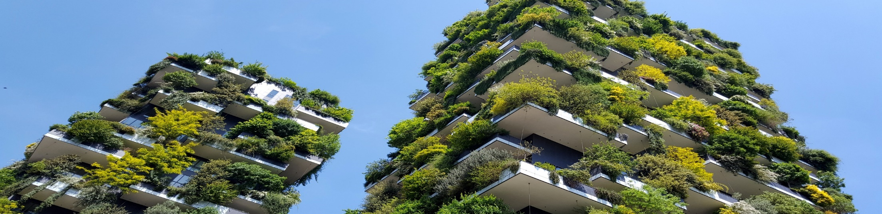

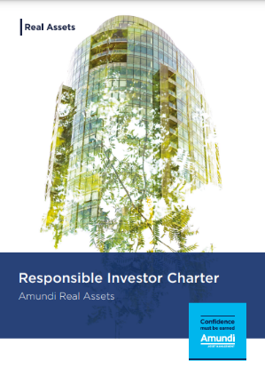

Amundi alternative and Real Assets: from esg towards impact
2012
2015
2017-2018
2019
2020
2021
2022
2023
2024
Launch of Finance and Solidarity, Amundi’s Social Impact Fund
ESG due diligence systematically applied in the Corporate Private Debt investment processes
Launch of Amundi Energy Transition’s ESG charter
The principles for Impact Investing in Private Debt are signed (Sustainability-Linked loans)
Launch of an ESG department at Amundi Real Assets
Launch of an Impact strategy in Real Estate
Publication of ARA’s 2022 Responsible Investor Report
Launch of an Impact strategy in Private Equity
ESG charter for the Private Debt division
Launch of the first 2021 Responsible Investor report for Amundi Real Assets
Launch of an Impact strategy in Direct Lending
Launch of an Article 9 fund in Infrastructures
Amundi Real Estate ESG Charter
Launch of Amundi Private Equity Funds’ ESG charter
Creation of the first Article 8 SFDR UCITS Hedge Fund.
ISR labeling of our Real Estate Funds
Launch of an Impact strategy in Corporate Private Debt
Read Amundi Real Assets’ 2023 Responsible Investor Report and Responsible Investor Charter for our six areas of expertise
HERE

Slide 14
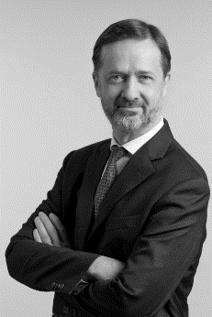
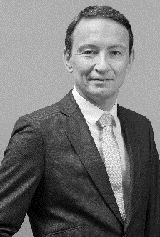
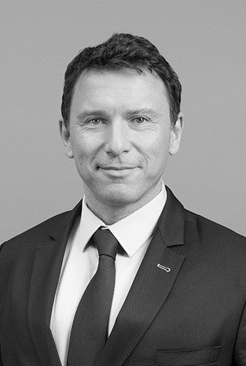
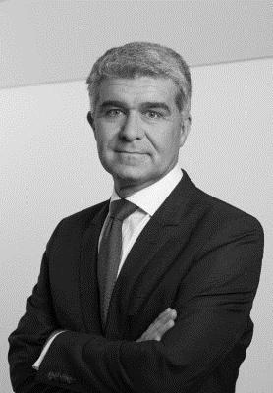


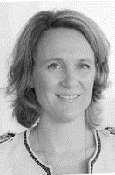
Amundi alternative and real assets executive committee
Dominique CARREL-BILLIARD
Global Head of Amundi Alternative and Real Assets
Lionel PAQUIN
Deputy Head of Amundi Alternative and Real Assets
Nathanael BENZAKEN
Global Business Development
Antoine AUBRY
Head of Amundi Real Estate
Thierry VALLIÈRE
Head of Private Debt
Hélène SOULAS
Chief Operating Officer
Amundi Alternative and Real Assets
Adelaide DE CASSON
General Secretary Amundi Alternative and Real Assets

Slide 15

DISCLAIMER
The information contained in this material is provided at your request, on a confidential basis only and for your sole use. It is not deemed to be communicated to, or used by, any person, qualified investor or not, from any country or jurisdiction which laws or regulations would prohibit such communication or use. This material is solely for the attention of “qualified investors” as defined in Directive 2003/71/EC dated 4 November 2003 on the prospectus to be published when securities are offered to the public and admitted to trading, or as the case may be in each local regulations.
Moreover, this material is for the attention of institutional, professional, qualified or sophisticated investors, under the applicable law and regulations. This material is not to be distributed to the general public, private customers or retail investors in any jurisdiction whatsoever nor to “US Persons” as this term is defined in SEC Regulation S under the U.S. Securities Act of 1933.
This material is provided at your request for information purposes only and does not constitute a recommendation, a solicitation, an offer, an advice or an invitation to purchase or sell any security or fund. This material is not a contract nor a commitment of any sort. This material may present information on projects of products that are not yet approved by or declared to the competent regulatory authorities. Amundi Asset Management is not bound by the characteristics of such projects as presented in this material. Such characteristics may vary over time. Your investment decision should only rely on the official documentation of these products once they are approved by or declared to the competent regulatory authorities.
All potential investors should determine prior to any investment decision the suitability of any investment as regards the enforceable regulations as well as the tax consequences of such an investment and should inspect regulatory documents in force for each product.
All potential investors should seek the advice of their legal and/or tax counsel or their financial advisor prior to any investment decision in order to determine the suitability of any investment before making any commitment or investment, in order to determine whether the investment is suitable for them, and should not only consider this material alone to make investment decisions.
Any projections, valuations and statistical analyses provided herein are provided to assist the recipient in the evaluation of the matters described herein. Such projections, valuations and analyses may be based on subjective assessments and assumptions and may use one among alternative methodologies that produce different results; accordingly such projections, valuations and statistical analyses should not be viewed as facts and should not be relied upon as an accurate prediction of future events. There is no guarantee that any targeted performance will be achieved.
The provided information is not guaranteed to be accurate, exhaustive or relevant: although it has been prepared based on sources that Amundi Asset Management considers to be reliable it may be changed without notice. Information remains inevitably incomplete, based on data established at a specific time and may change.
The information contained in this document may be regarded as the provision of a general investment advice, it is hereby reminded that this document has not been drafted in compliance with the regulatory requirements aiming at promoting the independence of financial analysis, Amundi Asset Management is therefore not bound by the prohibition to conclude transactions on the financial instruments mentioned in this document.
Amundi Asset Management accepts no liability whatsoever, whether direct or indirect, that may arise from the use of information contained in this material. Amundi Asset Management can in no way be held responsible for any decision or investment made on the basis of this information.
The information contained in this material shall not be copied, reproduced, modified, translated or distributed without the prior written approval of Amundi Asset Management, to any third person or entity in any country or jurisdiction which would subject Amundi Asset Management or any of its products, to any registration requirements within these jurisdictions or where it might be considered as unlawful. This material has not been reviewed by any financial regulator.
Amundi AM, a company incorporated under the laws of France registered with the Paris Registry of Commerce and Companies under number 437 574 452, having its registered office at 91-93 boulevard Pasteur, 75015 Paris, France, a management company approved by AMF – Autorité des Marchés Financiers –under the number GP 04000036.
Amundi Immobilier, a company incorporated under the laws of France registered with the Paris Registry of Commerce and Companies under number 315 429 837, having its registered office at 91-93 boulevard Pasteur, 75015 Paris, France, a management company approved by AMF – Autorité des Marchés Financiers –under the number GP 07000033.
Amundi Private Equity Funds, a company incorporated under the laws of France registered with the Paris Registry of Commerce and Companies under number 422 333 575, having its registered office at 91-93 boulevard Pasteur, 75015 Paris, France, a management company approved by AMF – Autorité des Marchés Financiers –under the number GP 99.015.
Amundi Transition Energétique, a company incorporated under the laws of France registered with the Paris Registry of Commerce and Companies under number 804 751 147, having its registered office at 91-93 boulevard Pasteur, 75015 Paris, France, a management company approved by AMF – Autorité des Marchés Financiers –under the number GP 16000012.
Amundi Alpha Associates AG is a a société anonyme (French public limited company) with a share capital of 250,000 Swiss francs and is authorised by the FINMA (Swiss Financial Market Supervisory Authority) as a collective wealth manager. Registered office:13 Bahnhofstrasse, 8001, Zurich, Switzerland. Siren (business registration no.): CH E 110.534.686, Commercial Register of the canton of Zurich.

