Slide 1
Amundi Technology, a new frontier for the financial industry
January 2023

Slide 2
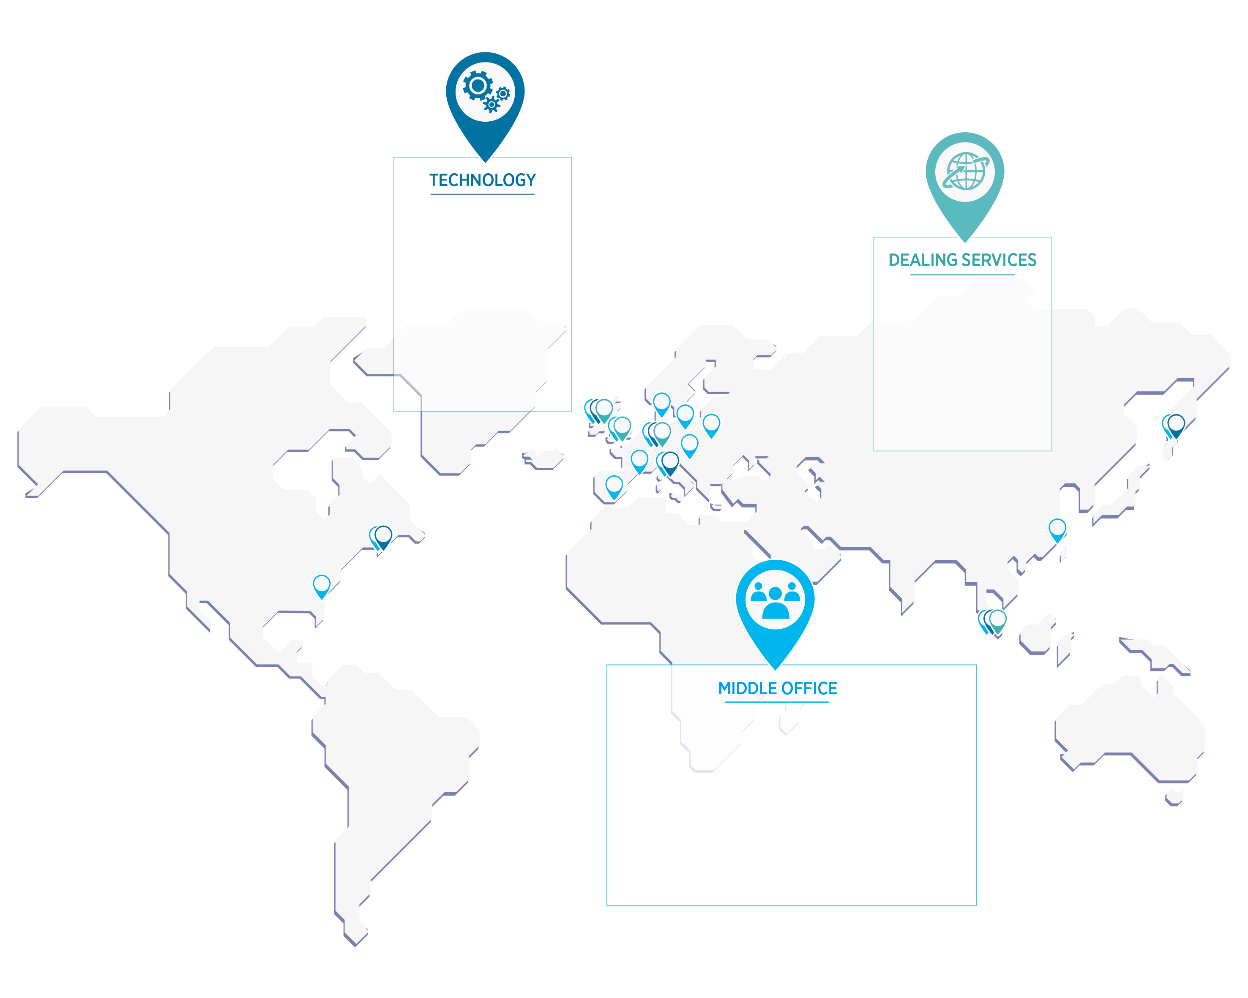
Amundi Technology: 900 professionals in 19 countries, serving Amundi and 42 external clients
Amundi Technology offers innovative technology and services to support clients reshaping their operating model. Our solutions aim at meeting our client needs in investment, wealth management, retail and distribution and providing them with high-performance tools to empower their business and help them focus on their core activities
Products
ALTO*
Investment
ALTO*
Wealth & Distribution
2 hubs Paris & Dublin
900 IT experts
19 local offices
ALTO* Employee Savings & Retirement
Specialized solutions
4 hubs
60 traders
2.6 millions
trades
> 42 Clients (extract)
2 hubs Paris & Dublin
12 local offices
400 middle-officer
130 data specialists
Key Differentiators
Ready to use
100% cloud solutions
Secured, trusted & regulated
Fast & cost-effective deployment
Global reach with local support
Independent, open & leading-edge technology
* ALTO: Amundi Leading Technologies & Operations

Slide 3
1
Amundi Technology Presentation

Slide 4
A fast-changing environment with inherent profitability risks and opportunities
Client Challenges
Asset Managers
Distributors & Savings
Pressure on margins in a highly-competitive market with increasing costs and a growth of passive management strategies
✓
✓
Complete and agile customer lifecycle management with seamless user experience across all distribution channels
✓
Operational excellence driven by high-value/high-touch approach and demand for automation of operations and decrease of operational risk
✓
✓
Increasing market requirements and cost of compliance with an evolution of rules and regulations for investors protection, particularly for transparency
✓
✓
Continuous investment to promote innovation and align platforms with industry standards and cutting edge technologies
✓
✓
Business Opportunities
Digitalize customer experience
Accelerate time-to-market
Manage data integrity
Benefit from continuous innovation
Improve economies of scale
* ALTO: Amundi Leading Technologies & Operations

Slide 5
The European leader’s¹ technology promise as a result of a successful development track record
Full spectrum of the investment value-chain developed through successive acquisitions and integrations
Complete coverage of investment, distribution strategies and asset classes
Integrated vision, industrial model and technological know-how
Efficient and reliable platforms
Highly efficient operating model, with a leading cost/income ratio in the industry
Core in-house developments and open standards with selected high-value partners
Substantial investments on reliable and cutting-edge technologies
Technology, a strategic priority driven by continuous investment
Primary technology centers in Paris and Dublin, expertise centers in the USA and Asia and worldwide local support in 19 countries
900 IT talents and 500 staff in operations (data mgmt., middle office, reporting)
Agile organization with IT teams close to investments, distributions and operations
Fast, effective and reliable time-to-market for platform deployment
Outstanding organization with talents & worldwide capabilities
* ALTO: Amundi Leading Technologies & Operations
1. Source: IPE “Top 500 asset managers” published in June 2021 and based on AUM as of December 2020.

Slide 6
Since its inception in 2012, ALTO* platform is continuously enriched through various integrations and is servicing external clients since 2019
2022
Acquisition of Lyxor AM (~€140bn AUM)
ESG: Acceleration of the technological and functional offer
2020
2019
Deployment in China (Bank of China) and Spain (Sabadell AM - €20bn) in 2020
Extension to real assets
Acquisition of WeSave
2022
2021
New solutions with ALTO* Sustainability and ALTO* Reporting
2018
39 clients in 9 countries
ALTO* Investment Compliance selected by 3 major asset servicing companies
ALTO* Employee Savings & Retirement extended to insurance products
ALTO* Wealth & Distribution in full development thanks to significant commercial success
1st major global migration of
Pioneer (€240bn, 7 countries) completed in 18 months
2020
24 clients in 6 countries
ALTO* Wealth & Distribution's first client in Austria
2012
2019
ALTO*'s first technological development
3 ALTO* Investment clients outside France
2016
1st ALTO* Investment client in France
* ALTO: Amundi Leading Technologies & Operations

Slide 7
Robust and innovative solutions enabling our clients to focus on their core business
Software as a Service (SaaS) running on private cloud
Innovative and scalable technology
Latest features: open source, API-based, NLP, Python, machine learning
Benefits from already large base of products and functionalities
Highly competitive
No maintenance or upgrades, a cost effective platform
Understanding needs of asset managers and financial institutions
Deep industry experience
Helping clients to focus on their core business
Augmented with services
Dealing, Middle Office, Data Management and Reporting services
Strong implementation capabilities
Fast, effective and reliable deployment
Global industrial model with flexibility for customized solutions

Slide 8
Amundi Technology and ALTO* offer: a suite of products covering the entire savings value chain
PRODUCTS
CLIENTS
ALTO* Investment: Flexible Portfolio Management System covering the entire asset management value chain
Asset Managers, Institutional Investors, Family Offices
ALTO* Wealth & Distribution: Modular platform for wealth managers, private banks and distributors
Wealth Managers, Private Banks,
Retail distribution networks
ALTO* Employee Savings & Retirement: Single management platform for employee and pension savings
Pension funds, Insurance Companies
Specialized solutions:
ALTO* Asset Servicing: Solutions for Asset Servicers, starting with depositary control
Custodians, Fund Administrators
ALTO* Sustainability: Solutions to meet ESG needs including data, analytics scorings, reporting, climate, etc.
Asset Managers, Institutional Investors, Wealth Managers
* ALTO: Amundi Leading Technologies & Operations

Slide 9
2
Focus on ALTO* platforms

Slide 10
ALTO* Investment, a multi-asset class investment platform for Asset Managers and Institutional Investors
Front-Office
Portfolio management,
design, optimization & analysis
Simulations
ESG
Look-through
Order booking
Dealing
Insurance & solvency
Cash management
Risk & Investment
Compliance
Market risk (VaR, TE)
Liquidity risk
Investment guidelines
Pre-trade controls
Post-trade controls
Stress tests
Dealing
Services
Data Management
Financial instruments
Portfolio & products
Index & benchmark
Ratings
ESG
Private & real assets
Data quality controls
Middle-Office
Position keeping IBOR
Trade & funds processing
OTC collateral servicing
Subscriptions & redemptions
Corporate actions & income
Reconciliations
NAV Control
Reference
Data
Services
ALTO* Investment
Middle-Office
Services
Reporting
Factsheet production
Dissemination
Data visualization
Open API
Performance
Measurement
Contribution
Attribution
Reporting
Services
ALTO* Platform
Operational services
* ALTO: Amundi Leading Technologies & Operations

Slide 11
ALTO* Wealth & Distribution, a core-to-digital platform for wealth management
On-demand or mass rebalancing Advisory proposal
Clients constraints / preferences
Portfolio model & optimization
Compliance pre & post-trade
Dealing services
MO & data
services
Positions and transactions integration
Performance and risk
Cash management
Order processing
Wealth
Management
Middle-Office &
Data Management
Client
Self-care & Robo-Advisor
ALTO* Wealth & Distribution
360° view for clients and advisors
External account aggregation
Client digital onboarding
KYC and risk profiling
Robo-advisory integrated
Wealth Reporting generation and dissemination
Client Life-cycle Management
Commercial dashboard
Digital Monitoring & Reporting
ALTO* W&D Platform
Operational services (BPO)
* ALTO: Amundi Leading Technologies & Operations

Slide 12
ALTO* Employee Savings & Retirements
A front-to-back platform to manage employee savings and retirement solutions in a multi-insurer and multi-account keeper framework
A modular integration with the clients’ information systems
A highly regulated platform supporting millions of customers
Subscription
Transfer agent
PORTALS
Company
Employee
Partner
REFERENTIAL
CORE PLATFORM COMPONENT
BACK
Subscription & redemption management
Payment
Order booking
Master data
Reporting
Accounting sub ledger
Product
Billing
Data warehouse

Slide 13
Other specialized solutions leveraging on Amundi experience and know-how
Solutions capitalizing on Amundi experience in the asset management value chain
Capacity to develop bespoke solutions for Amundi and external clients
Strong R&D investments to develop state-of-the-art platforms adapted to meet the requirements of Asset Managers
ALTO* Asset Servicing
ALTO* Sustainability
An industrial and flexible investment compliance solution enabling effective trustee control:
Program and design investment rules for portfolio breakdown & ratios
Manage investment rules, guidelines & breaches to ensure post-trade compliance
Produce client reporting with bespoke reports
A unique platform tracking ESG analytics, access to data, produce reporting, stress test portfolios, etc.
ESG
Regulatory metrics
Climate
Impact
Targets: Asset servicer (Custodians, Fund Admin & Trustee)
Targets: Asset Managers, Banks & Institutional Investors

Slide 14
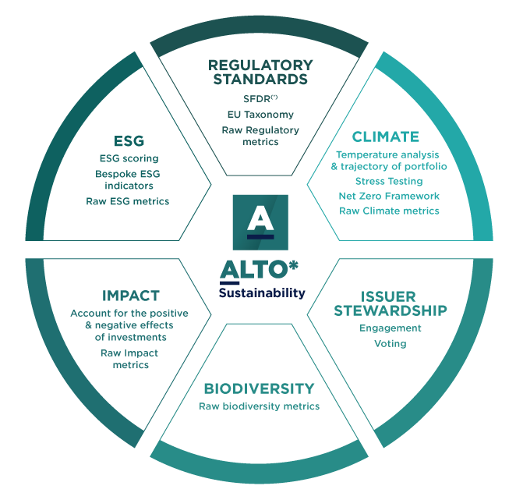
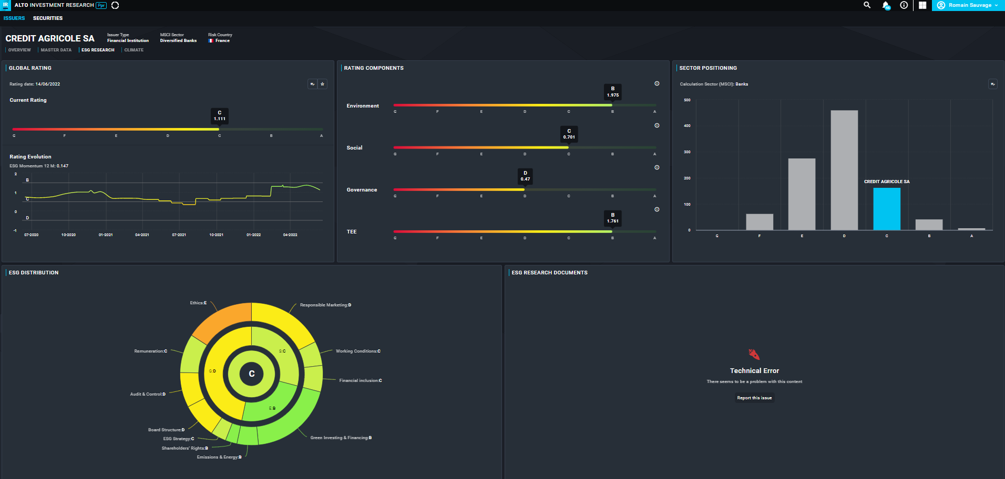
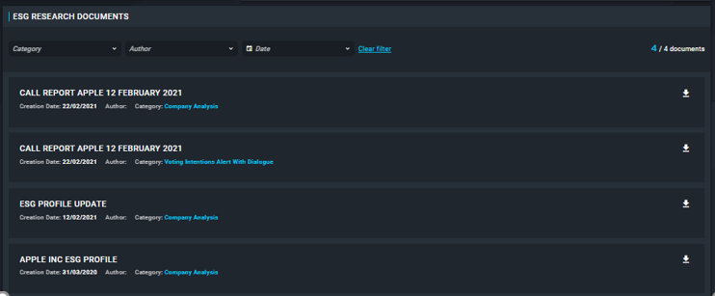
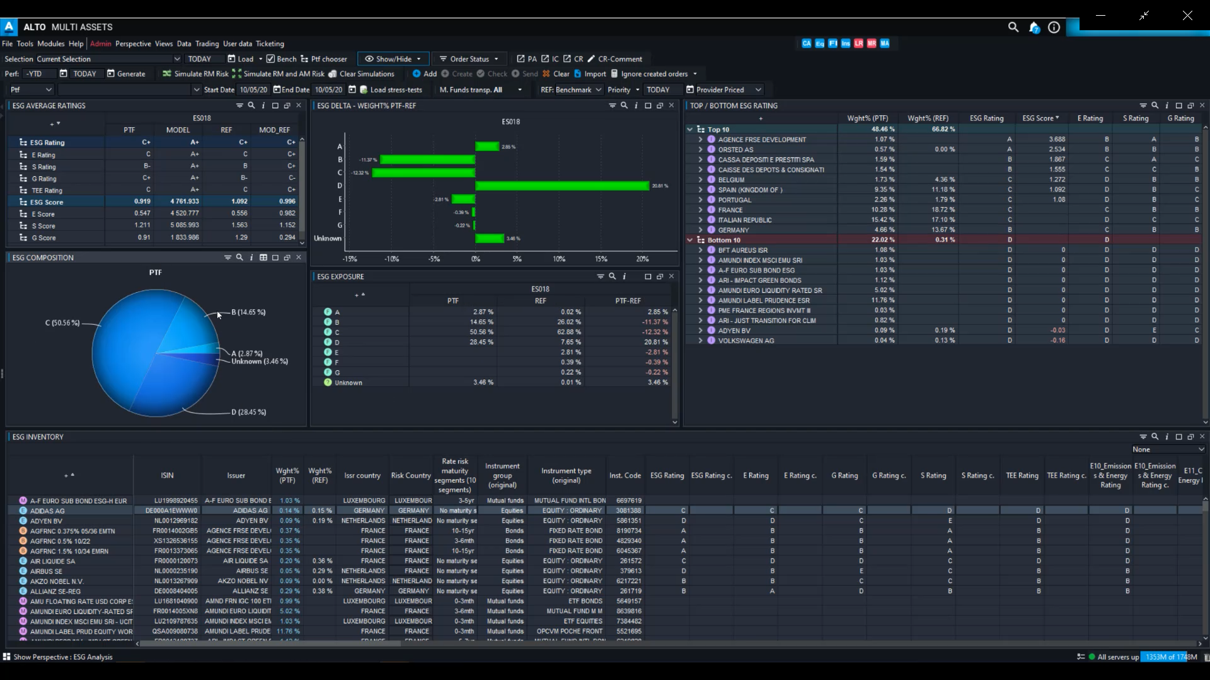
ALTO* Sustainability to empower responsible investors
2
ESG issuer analysis with ALTO* Investment Research
1
3
ESG Portfolio Analysis with ALTO* Investment
6
4
5
Scope of services available for Amundi Technology clients in Q1 2023
* ALTO: Amundi Leading Technologies & Operations

Slide 15
ALTO* Sustainability leveraging ALTO* Platform
ALTO* Sustainability is powering sustainable and ESG investing, enabling clients to align investment decisions with their ESG and climate goals.
Give users the data and tools needed to consolidate ESG and sustainable analytics
Use ESG data into the front-to-back workflow for portfolio analysis and design, compliance control, regulatory requirement, and reporting
Data services managed by Amundi
ALTO* Sustainability
ALTO* Investment
ESG methodology
ESG data visualization
Portfolio analysis
Compliance
Reporting
Multi-source data integration
Data processing: sourcing, matching, integration, administration, and quality control
3 options available for data services: standard, advanced and BYOD (Bring Your Own Data)
Create a dedicated sustainability methodology aligned with client sustainability metrics requirements
Manage and administrate the composite scoring
Consultation screens for ESG data visualization, scoring and attributes overrides, audit trail, API and administration screens
Issuer analysis with actual and historical sustainability ratings
Portfolio and holdings ESG ratings
Portfolio Design
Dashboard for portfolio overview
Comparison to portfolio benchmark
Look-through
Carbon emissions, climate, temperature
SFDR (taxonomy, PAI and SI)
Pre-trade and post trade controls and monitoring on sustainability analytics
Sustainability reports production and quality monitoring
Out-of-the-box reports templates library for customization with advanced designer and white labelling
SFDR data
Nota: Target Operating Model to be defined depending on client requirements
* ALTO: Amundi Leading Technologies & Operations

Slide 16
3
Appendices

Slide 17
Best-in-class platforms with the guarantee of fast and low-risk implementation
Full suite of ready to use solutions covering the entire investment and distribution life cycle, including Data Management services
Integrated or standalone operational services for Dealing, Middle Office and Reporting depending on clients’ operating model
Integrated and modular FO/MO/Risk value proposition
Private cloud infrastructure relying on best-practice security standards
Segregation of data and duties to ensure separation of client data and operations
Highly secure infrastructure
Flexible client integration approach blending global industrial model with client specific requirements
Proven implementation based on a unique “parallel run” approach supporting easy adoption and integration of user experience
Fast, cost-effective and reliable implementation
Worldwide presence led by Paris and Dublin offices
Close and local support in 40 countries
Global reach with close and local support
Open architecture allowing APIs for third party niche software integration and client data servicing
Specialized solutions leveraging on Amundi experience and know-how
Independent, open and leading-edge technology

Slide 18
Worldwide connectivity, capabilities and ecosystem
150+ market data sources
10 fund distribution platforms
10+ Banks information system & 2 insurers
Market data
Distribution
Banks & insurers
70+ Custodians, 60+ Fund Administrators & 40+ Transfer Agents
250+ execution counterparties
Asset servicer
Amundi
Technology
Ecosystem connectivity
Counterparties
Key volumes
Portfolios
Trading & execution
16,000+ portfolios, 200,000+ DPM mandates, 5,000 indexes and 8,000 benchmarks
3.5 million trades with an annual value of €6,100 billion
ALTO* users
Retail, Wealth & Distribution users
4,000+ ALTO* Investment users
60,000+ ALTO* Wealth & Distribution users
4 million retail users
500,000 Employee Savings & Retirement mobile app downloads
3 million app connection/months
Source: Amundi as of 31/12/2021

Slide 19
Strategic partnerships and operational integrations to offer clients best-in-class value-added solutions
Strategic partnerships with Asset Servicers
PARTNERS
& INTEGRATION
Technology & operational integration
ALTO* x CACEIS
Fully integrated front-to-back solution combining technology and services, to offer a portfolio management platform, Dealing, Middle-Office, custodian and fund administration services
ALTO* x BNY
A transatlantic collaboration to provide clients with a unique integration of world-class complementary capabilities relying on a joint integrated front-to-back operating model to power investment lifecycle and deliver greater efficiency
Integration with MSCI RiskMetrics for market risk availability in ALTO*
Integration with FactSet for performance analytics availability in ALTO*
* ALTO: Amundi Leading Technologies & Operations

Slide 20
A growing client base with 42 clients in Europe and Asia
ALTO* INVESTMENT
ALTO* WEALTH & DISTRIBUTION
ALTO* ASSET SERVICING
ALTO* EMPLOYEE SAVINGS & RETIREMENT
Amundi data as of 30/04/2022
* ALTO: Amundi Leading Technologies & Operations

Slide 21
“Solutions designed by an Asset Manager for Asset Managers, a Distributor for Distributors and an Investor for Investors”
Confidence is earned through technology

