Slide 1
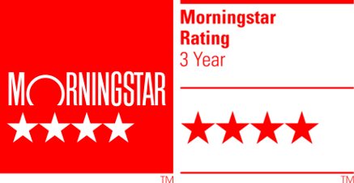
Good Things Come in 3’s: Alpha, Income, Sustainability!
AF Global Equity Sustainable Income
January 2023

Slide 2
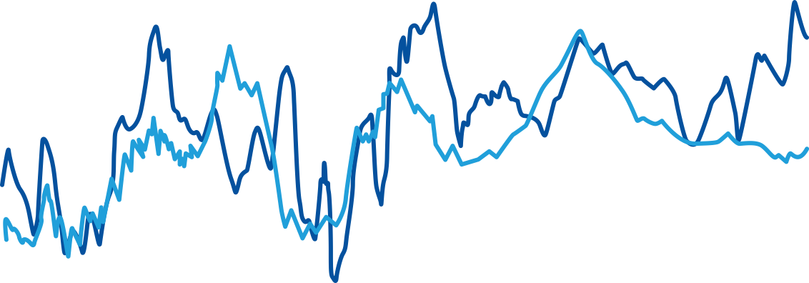
Dividends can hedge inflation and dampen volatility…
… and reduce volatility
Dividends grow with inflation…
Dividend Growth
CPI Growth
Past performance does not guarantee future results. Indices are unmanaged and not available for direct investment. For illustrative purpose only. Data Sources: Ned Davis Research and Hartford Funds, 12/21.
Source: Robert Shiller, SG Cross Asset Research/Equity Quant, data as at 31 March 2022.

Slide 3
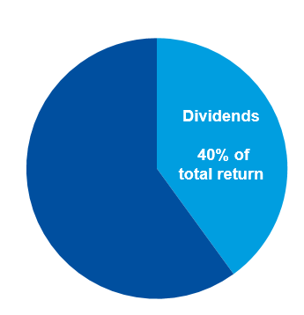
… but don’t forget that dividends are important for total returns
Historically…

Slide 4

Dividends are good, “Sustainable Dividends” are great!
Helps Avoid Risk
Provides Opportunity
Dividend Growth
Sustainability Controversies
Can severely inhibit a company’s future likelihood of success
Sustainability
Time
Time
Think about electric cars. For an automaker, are electric cars an ESG issue or a financial issue?

Slide 5
Financial sustainability is as important
Higher FCF yield than the benchmark
Reducing leverage given higher rates

Slide 6


Diversification with “Anchors” and “Compounders”
Dividend Compounder: Deere
Dividend Anchor: KDDI
Deere is a leading agricultural equipment maker. Strong exposure to structural themes of food security, farm efficiency.
KDDI is a leading Japanese telecommunications company with a good ESG rating.
1.4% yield at the time of purchase, but strong earnings growth to drive dividend growth. Company is committed to rising dividend payout.
Attractive market because of limited competition, stable market shares, and a good pricing environment – supporting cash flow generation.
Outlook for future profit growth is improving which ultimately supports dividend growth.
c.4% dividend yield which is well supported by its strong financial position.

Slide 7
This diversification allows for balance

Slide 8

Did you know…?
…that you could invest in a US technology company with a 3% dividend yield?
Market sell off in September gave us the opportunity to add this high quality semiconductor maker. It gives us exposure to structural trends in industrial and auto markets.
The company is committed to cash flow growth, helping to support dividend growth.
Management have a strong track-record for capital allocation, i.e. they invest in value creating projects. This bodes well for the dividend trajectory.

Slide 9



Bringing it to life: “Agility” at the core of our process
Buy:
Sold:
Has the market sold off too much? Where are the pockets of value?
What lower quality defensives do we have that have outperformed?
Are we seeing income opportunities in “growth”?

Slide 10
Allowing us to stand out from the crowd
Keeping pace with the market recovery
Source: Amundi Asset Management as of 30/12/2022. *The benchmark is MSCI World. Data above refers to Class I2 Net performance in euro terms with dividend reinvested. Past performance does not predict future results. Investment return and the principal value of an investment in the Funds or other investment product may go up or down and may result in the loss of the amount originally invested. On 20/01/2020 Amundi Funds Global Equity Target Income became Amundi Funds Global Equity Sustainable Income. The following information is additional to, and should be read only in conjunction with, the performance data presented above.

Slide 11
Performance and Peer Ranking
 | YTD % Rank | 1 Year % Rank | 3 Years % Rank | 5 Years % Rank
AF Global Equity Sustainable Income I2 USD C | 21 | 21 | 8 | 20
Net performance (EUR) as of 31/12/2022 | YTD | 1 year | 3 years Annualised | 5 years Annualised
Portfolio | -1.5% | -1.5% | 7.9% | 7.7%
Benchmark | -12.8% | -12.8% | 6.7% | 8.7%
Excess Return | +11.3% | +11.3% | +1.2% | -1.0%
AuM in Fund (€) | 1.4bn
Portfolio Managers | P. Iaccarino P. O’Donoghue
Sus. Income 2023 | 3.5%
Past performance does not predict future results.
Source: Amundi Asset Management as of 31/12/2022. *The benchmark is MSCI World. Data above refers to Class I2 Net performance in euro terms with dividend reinvested. Past performance does not predict future results. Investment return and the principal value of an investment in the Funds or other investment product may go up or down and
may result in the loss of the amount originally invested. On 20/01/2020 Amundi Funds Global Equity Target Income became Amundi Funds Global Equity Sustainable Income. The following information is additional to, and should be read only in conjunction with, the performance data presented above.

Slide 12
Where the stars align
Unique approach,
diversified, focus on “Sustainable Dividends”
Top quartile performance, +11.2% alpha in 2022!
Using dividend income to protect against inflation and dampen volatility.
+350m euros net flows in 2022… more to come!

